Slide 1


Biological Psychology
Thirteenth Edition
Chapter 4
Genetics, Evolution, Development and Plasticity
© 2019 Cengage. All rights reserved.

Slide 2
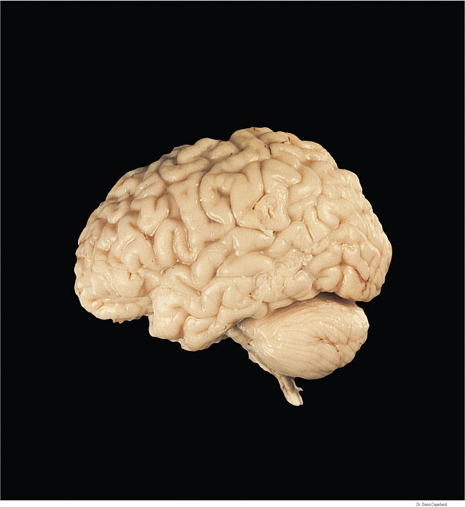
The brain of a one-year old
An enormous amount of brain development has already occurred by the time a person is 1 year. This is a brain of a one-year old.

Slide 3
4.1 Genetics and Evolution of Behavior
Does human behavior depend on…
  genetics?
  environmental influences?
  or both?
…A review of genetics provides a springboard for evaluating this controversial question…

Slide 4
Genetics and Behavior
Both genes and the environment interact to shape human behavior
Fundamental issue is how much each factor plays a role in shaping human behaviors
  Examples: psychological disorders, weight gain, personality, sexual orientation

Slide 5
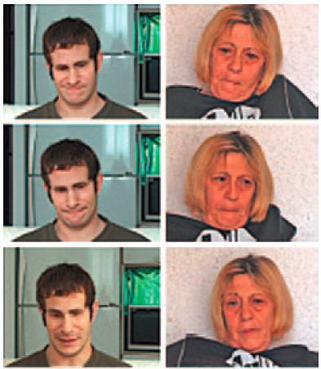
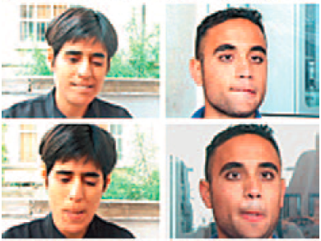
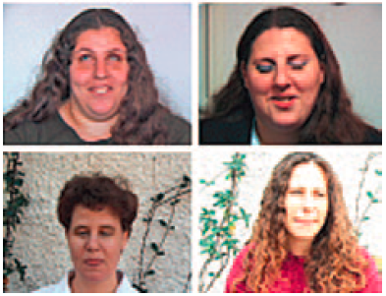
A Genetics Contribution to Facial Expression
Figure 4.1 Facial expressions by people born blind (left) and their sighted relatives (right)
The similarities imply a genetic contribution to facial expressions.
Notes:
Figure 4.1 Facial expressions by people born blind (left) and their sighted relatives (right)
The similarities imply a genetic contribution to facial expressions.
Hereditary Family Signature of Facial Expression, PNAS, vol. 103, no. 43, October 24, 2006. Copyright 2006 National Academy of Science, U.S.A. Copyright 2006 National Academy of Sciences, U.S.A.

Slide 6
Mendelian Genetics
19th century monk Gregor Mendel demonstrated…
→ inheritance occurs through genes
Genes…
  are discrete units of heredity
  in pairs (called alleles)
  on chromosomes (strands of genes)
Notes:
Prior to Mendel, it was commonly believed that inheritance was a blending process of the properties of the egg and sperm (like paint).

Slide 7
Mendelian Genetics – DNA and RNA
A gene is…
  a portion of a chromosome
  composed of deoxyribonucleic acid (DNA)
DNA serves as a model for the synthesis of ribonucleic acid (RNA)

Slide 8
Mendelian Genetics – DNA and RNA (cont’d.)
RNA…
  is a single strand chemical
  that serves as a template/model for the synthesis of proteins (messenger RNA)

Slide 9
Mendelian Genetics –Proteins
Proteins determine body development by:
  Forming part of body’s structure
  Serving as enzymes, biological catalysts that regulate body’s chemical reactions

Slide 10
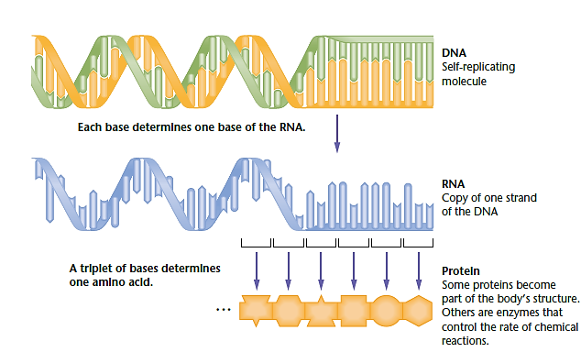
How DNA Controls the Development of an Organism (Figure 4.2)
The sequence of bases along a strand of DNA determines the order of bases along a strand of RNA; RNA in turn controls the sequence of amino acids in a protein molecule.
Notes:
Figure 4.2 How DNA controls development of the organism
The sequence of bases along a strand of DNA determines the order of bases along a strand of RNA; RNA in turn controls the sequence of amino acids in a protein molecule. © Cengage Learning 2013.

Slide 11
Mendelian Genetics – Heterozygous and Homozygous Genes
Homozygous (genes)
→ individual has an identical pair of genes on the two chromosomes
Heterozygous (genes)
  → individual has an unmatched pair of genes on the two chromosomes

Slide 12
Mendelian Genetics – Dominant and Recessive Genes (1 of 2)
Genes are dominant, recessive, or intermediate
  Examples: eye color, ability to taste PTC

Slide 13
Mendelian Genetics – Dominant and Recessive Genes (2 of 2)
Dominant genes- show a strong effect in either homozygous or heterozygous condition
Recessive genes- show effects only in the homozygous condition
Intermediate genes- show incomplete dominance in the heterozygous condition

Slide 14
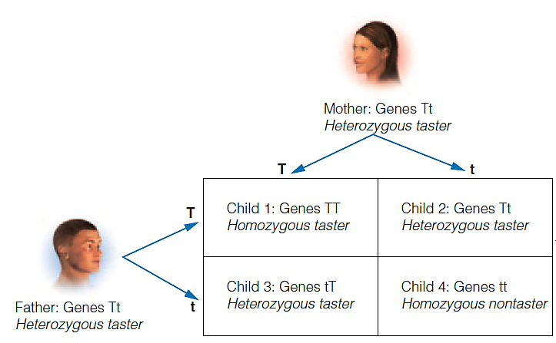
Four Equally Likely Outcomes of a Mating Between Heterozygous Tasters (Figure 4.3)
A child in this family has a 25 percent chance of being homozygous for the dominant gene (TT), a 25 percent chance of being homozygous for the recessive gene (tt), and a 50 percent chance of being heterozygous (Tt).
Notes:
Figure 4.3 Four equally likely outcomes of a mating between parents who are heterozygous for a given gene (Tt)
A child in this family has a 25 percent chance of being homozygous for the dominant gene (TT), a 25 percent chance of being homozygous for the recessive gene (tt), and a 50 percent chance of being heterozygous (Tt). © Argosy Publishing Inc.

Slide 15
Mendelian Genetics – Gene Expression
Examples like PTC & hair color can be misleading…
  Implies single gene combination completely controls a characteristic
  → This is not always true!
Some genes are only expressed partly…
  in some cells and not others OR
  only under certain circumstances

Slide 16
Mendelian Genetics – X and Y
Humans have 23 pairs of chromosomes:
  22 pairs of autosomes
  1 pair of sex chromosomes
In mammals, sex chromosomes are X & Y
  Females have two X chromosomes (XX)
  Males have an X and a Y chromosome (XY)

Slide 17
Mendelian Genetics – X and Y (cont’d.)
During reproduction:
  Females contribute an X chromosome
  Males contribute either an X or a Y
    X chromosome contributed by father → offspring is female
    Y chromosome contributed by father → offspring is male

Slide 18
Male and Female Karyotypes
[Photograph of male
and female karyotypes]
The male karyotype (left) shows the 22 pairs of autosomal chromosomes and the 2 sex chromosomes—an elongated X and a shorter Y chromosome. The photographic arrangement of a female’s chromosomes (right) shows 2 X chromosomes.
Notes:
Figure from “Life-Span Human Development” text, Sigelman and Rider 9th edition

Slide 19
Types of Genes
Types of genes include:
  Autosomal genes: all other genes except those on the sex chromosomes
  Sex-linked genes: genes located on one of the sex chromosomes
  Sex-limited genes: genes that are present in both sexes but mainly have an effect on one sex (chest hair, breast size, etc.)

Slide 20
Mendelian Genetics – Sex-Linked and Sex-Limited Genes
Human Y chromosome…
→ genes for 27 proteins
Human X chromosome…
→ genes for ~1500 proteins
Thus, sex-linked genes usually refer to X-linked genes (e.g., red-green color deficiency)
[Sex-limited genes are usually on autosomes]

Slide 21
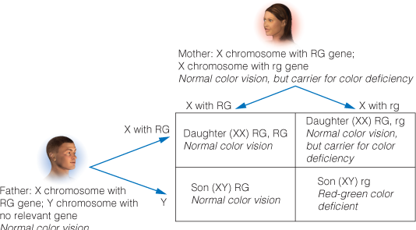
Red-green color deficiency, a sex-linked gene (Figure 4.4)
RG represents normal red-green color vision, and rg represents red-green color deficiency. Any son who receives an rg gene from his mother is red-green color deficient, because the Y gene has no gene for color vision. A daughter could be color deficient only if her father has color deficiency and her mother is a carrier for the condition.
Notes:
Figure 4.4 Red-green color deficiency, a sex-linked gene
RG represents normal red-green color vision, and rg represents red-green color deficiency. Any son who receives an rg gene from his mother is red-green color deficient, because the Y gene has no gene for color vision. A daughter could be color deficient only if her father has color deficiency and her mother is a carrier for the condition.

Slide 22
Genetic Changes
Genes change in several ways:
  Mutation: heritable change in DNA molecule
  Microduplication/microdeletion: part of a chromosome that normally appears once might appear twice or not at all
  Example: some researchers believe schizophrenia may involve microduplications & microdeletions of brain-relevant genes

Slide 23
Epigenetics
Epigenetics: changes in gene expression without modification of DNA sequence
  Some genes active only at a certain point in one’s life, a certain time of day, etc.
  Changes in gene expression are central to learning and memory
Epigenetics- likely explanation for differences between monozygotic “identical” twins

Slide 24
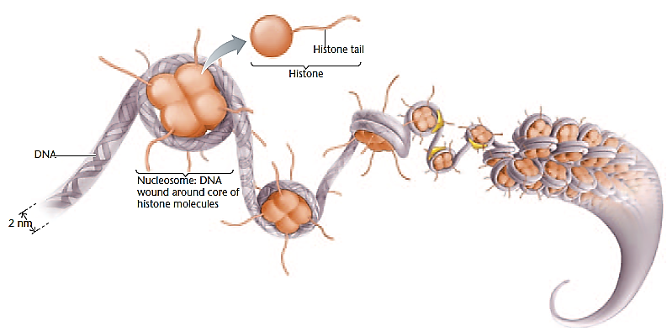
Activation of Certain Genes
Figure 4.5 DNA bound into a ball shape by histone proteins
Acetyl groups that attach to a loose end of a histone molecule loosen the histone’s grip on DNA, exposing more genes to the possibility of being active.
Notes:
Figure 4.5 DNA bound into a ball shape by histone proteins
Acetyl groups that attach to a loose end of a histone molecule loosen the histone’s grip on DNA, exposing more genes to the possibility of being active. © Cengage Learning 2013.

Slide 25
Epigenetic Effects
What you do at any moment not only affects you now…
…but produces epigenetic effects that alter gene expressions for a longer time
Experiences alter the activity of genes!

Slide 26
Heritability
Heritability= how much characteristics depend on genetic differences
Researchers have found evidence for heritability in almost every behavior tested
  Heritability of a certain trait is specific to a given population
  Strong environmental influences may cause genetic influences to have less effect

Slide 27
Heredity and Environment (1 of 2)
Almost all behaviors have both a genetic and an environmental component

Slide 28
Heredity and Environment (2 of 2)
Researchers study:
monozygotic (“from one egg”)/identical twins & dizygotic (“from two eggs”)/fraternal twins
  →infer hereditary & environmental influences
adopted children and resemblance to their biological parents
  →infer hereditary influences
Identify specific genes linked to behaviors

Slide 29
“Twins” power point links…
Identical twin photos: http://www.dailymail.co.uk/news/article-2333645/Can-tell-difference-Photographer-captures-striking-similarities-identical-twins.html
Effects of smoking: http://www.businessinsider.com/how-smoking-ages-the-face-of-identical-twins-2013-11
Natl Geo “In the Womb”: http://natgeotv.com/ca/in-the-womb/galleries/in-the-womb-identical-twins#1039
Fraternals who look similar: http://community.babycenter.com/post/a21830329/do_your_fraternal_twins_look_identical
Triplet birth news item: http://sacramento.cbslocal.com/2013/12/04/couple-gives-birth-to-rare-natural-identical-triplets-in-sacramento/

Slide 30
Environmental Modification
Traits with a strong hereditary influence can by modified by environmental intervention
  e.g., PKU (phenylketonuria): a genetic inability to metabolize the amino acid phenylalanine
  Environmental interventions can modify PKU

Slide 31
How Genes Affect Behavior
Genes…
Do not directly produce behaviors
Produce proteins that increase probability behavior develops under certain circumstances
Can also have an indirect affect…
  Genes can alter your environment by producing behaviors or traits that alter how people in your environment react to you

Slide 32
The Evolution of Behavior (1 of 2)
Evolution = change in frequency of genes
  in a population
  over generations
REGARDLESS if helpful/harmful to species

Slide 33
The Evolution of Behavior (2 of 2)
Evolution attempts to answer two questions:
  How did some species evolve?
  How do species evolve?

Slide 34
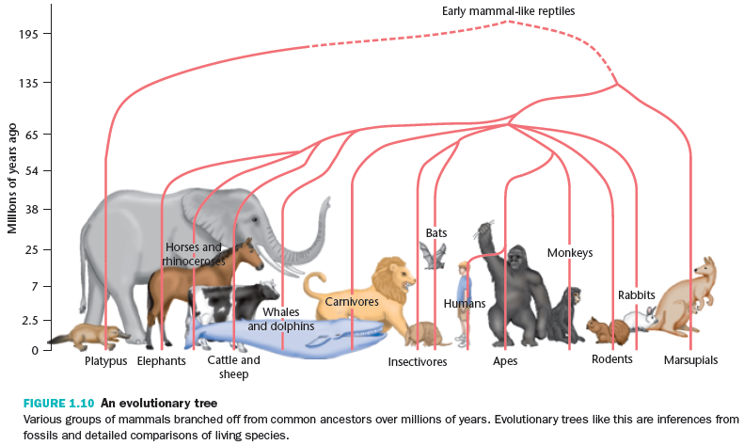
How Did Some Species Evolve?
(Figure not in 12th/13th edition)
Tentative construction of “evolutionary trees” (based on inferences from fossils/comparisons of living species)

Slide 35
How Do Species Evolve?
How species do evolve involves assumptions:
  Offspring resemble parents for genetic reasons
  New heritable variations occur (mutations, recombination, microduplications)
  Certain individuals successfully reproduce more than others do

Slide 36
Artificial Selection
Artificial selection =
  choosing individuals with desired traits
  making them parents of next generation
Natural selection- according to Darwin:
  nature also selects
  successful individuals’ genes will increase in later generations

Slide 37
Common Misconceptions about Evolution
Lamarckian evolution: “The use or disuse of some structure or behavior causes an increase or decrease in that behavior”
“Humans have stopped evolving”
“Evolution means improvement”
“Evolution acts to benefit the individual or the species”

Slide 38

Have humans stopped evolving?
China’s policy to limit each family to one child decreases the possibility of genetic changes between generations.

Slide 39
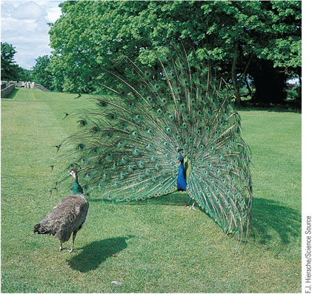
Does “evolution” mean “improvement”?
Sometimes, a sexual display, such as a peacock’s spread of its tail feathers, improves reproductive success and spreads the associated genes. In a changed environment, this gene could become maladaptive.

Slide 40
Brain Evolution
One explanation: our ancestors got enough nutrition to provide a big brain with all the fuel needed
  Cooking food → easier to digest
  Group hunting → more efficient
  Humans have better capacity for glucose transport

Slide 41
Evolutionary Psychology
Evolutionary psychology
  focuses on functional & evolutionary explanations of how behaviors evolved
  assumes species’ characteristic behaviors:
    1) have arisen through natural selection
    2) provide a survival advantage
    Examples: differences in peripheral/color vision, sleep mechanisms, eating habits, temperature regulation

Slide 42
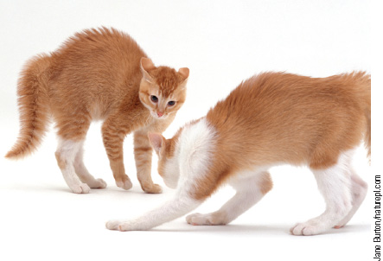
A frightened cat with erect hairs
Figure 4.6 A frightened cat with erect hairs
For animals with long hairs, erecting those hairs increases insulation from cold and makes the animal look larger and more dangerous. We humans continue to erect our hairs in those same situations as a remnant from our evolutionary past.
Notes:
Figure 4.6 A frightened cat with erect hairs
For animals with long hairs, erecting those hairs increases insulation from cold and makes the animal look larger and more dangerous. We humans continue to erect our hairs in those same situations as a remnant from our evolutionary past.

Slide 43
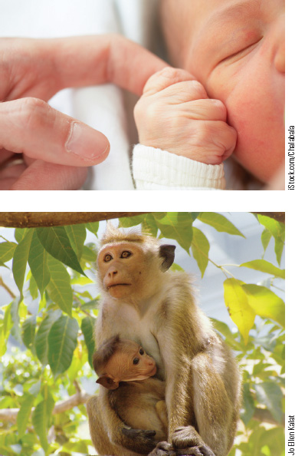
Grasp Reflex in Human and Monkey Infants
Figure 4.7 Grasp Reflex in Human and Monkey Infants
The grasp reflex, which accomplishes little or nothing for human infants, makes sense as an evolutionary remnant of a behavior necessary for the survival of our monkey-like ancestors.
Notes:
Figure 4.7 Grasp Reflex in Human and Monkey Infants
The grasp reflex, which accomplishes little or nothing for human infants, makes sense as an evolutionary remnant of a behavior necessary for the survival of our monkey-like ancestors.

Slide 44
Behavior and Natural Selection
Influence of natural selection debatable for some behaviors- examples:
  Life span length
  Gender differences in sexual promiscuity
  Altruistic behavior: behavior that benefits someone other than the actor
    Hard to find in non-human species

Slide 45
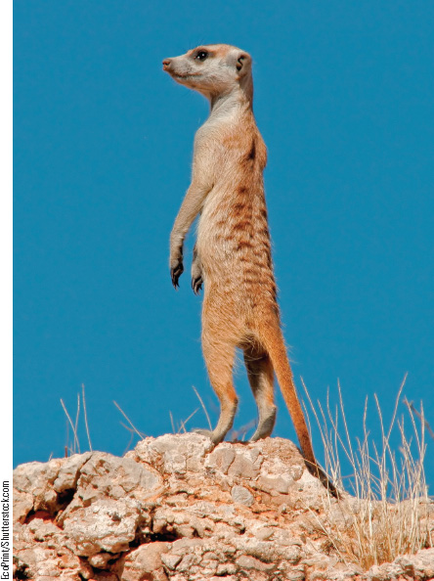
Sentinel Behavior: Altruistic or Not?
Figure 4.8 Sentinel Behavior: Altruistic or Not?
As in many other prey species, meerkats sometimes show sentinel behavior in watching for danger and warning the others. However, the meerkat that emits the alarm is the one most likely to escape the danger.
Notes:
Figure 4.8 Sentinel Behavior: Altruistic or Not?
As in many other prey species, meerkats sometimes show sentinel behavior in watching for danger and warning the others. However, the meerkat that emits the alarm is the one most likely to escape the danger.

Slide 46
Group and Kin Selection
A gene only spreads if…
individuals with it reproduce those without
A gene benefiting species but not individual…
dies out with that individual

Slide 47
How does a “bad” trait persist? “Heterozygote advantage”
[Images removed-
see website]
Below- normal RBCs
Right- RBCs in sickle cell
crisis- block capillaries-
BUT resist malaria also
Photos (#6,29,30) from: http://library.med.utah.edu/WebPath/HEMEHTML/HEMEIDX.html#3

Slide 48
Group and Kin Selection (cont.’d)
Group selection
  controversial hypothesis
  states that altruistic groups survive better than less cooperative ones
Kin selection
  more plausible
  selection for genes that benefit individual’s relatives

Slide 49
Reciprocal Altruism
Reciprocal altruism
  individuals help those that will return favor
Building reputation for helpfulness only works:
  if others are willing to cooperate
  if individuals recognize each other
    → Altruism video from Cengage

Slide 50
4.2 Development of the Brain
Brain development depends upon:
  Maturation
  Learning
We can refine this understanding by learning how:
  Neurons develop
  Their axons connect
  Experience modifies development

Slide 51
Maturation of the Vertebrate Brain
Human central nervous system begins to form when embryo is ~2 weeks old
  Dorsal surface thickens, forms neural tube surrounding fluid filled cavity
  Forward end enlarges
    differentiates: hindbrain, midbrain, & forebrain
  Rest of neural tube becomes spinal cord

Slide 52
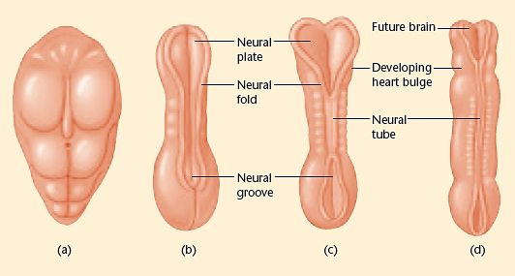
Early Development of the Human Central Nervous System (Figure 4.9)
The brain and spinal cord begin as folding lips surrounding a fluid-filled canal. The stages shown occur at approximately 2 to 3 weeks after conception.
Notes:
Figure 4.9 Early development of the human central nervous system
The brain and spinal cord begin as folding lips surrounding a fluid-filled canal. The stages shown occur at approximately 2 to 3 weeks after conception. © Cengage Learning 2013

Slide 53
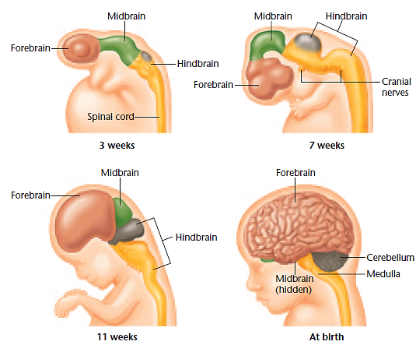
Figure 4.10 Human brain at four stages of development The growing forebrain quickly surrounds the midbrain and part of the hindbrain.
Notes:
Figure 4.10 Human brain at four stages of development
The growing forebrain quickly surrounds the midbrain and part of the hindbrain. © Cengage Learning 2013

Slide 54
Cerebrospinal Fluid
Fluid-filled cavity becomes:
  central canal (spinal cord)
  four ventricles (brain)
  Fluid= cerebrospinal fluid (CSF)

Slide 55
Brain Weight
Human brain weight:
  Birth= ~ 350 grams
  1 year= ~1000 grams
  Adult= ~1200-1400 grams

Slide 56
The Development of Neurons
Stages of neuron development:
  Proliferation
  Migration
  Differentiation
  Myelination
  Synaptogenesis

Slide 57
1. Proliferation
Proliferation= production of new cells/neurons in brain- primarily occurring early in life
Early development- cells lining ventricles divide
  Some cells become stem cells (continue to ÷)
  Others remain where they are OR
  become neurons/glia & migrate to other locations

Slide 58
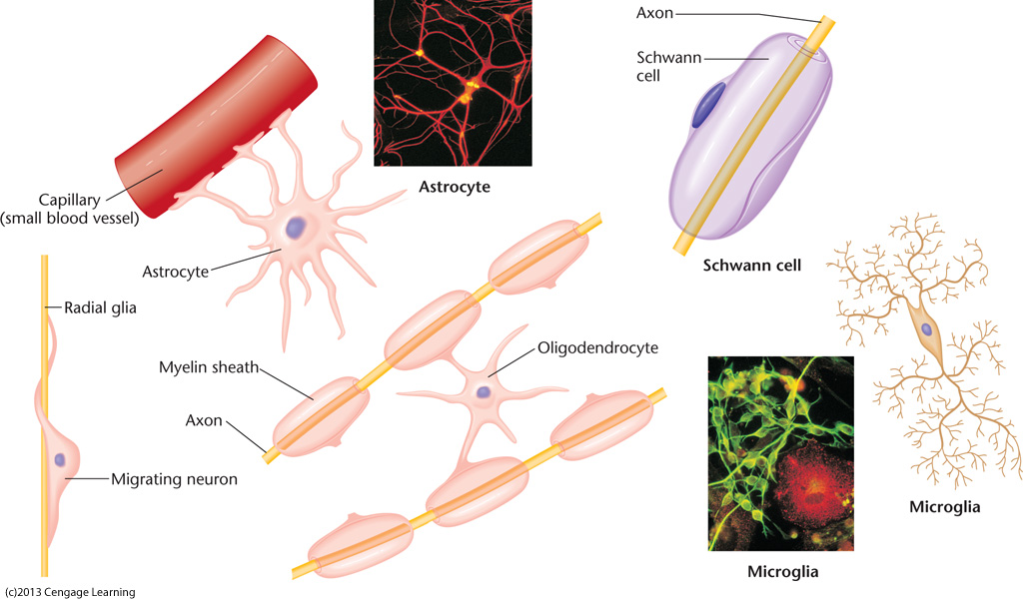
2. Migration
Migration= movement of newly formed neurons & glia to eventual locations
  Some don’t reach destinations until adulthood
  Occurs in many directions throughout brain
  Occurs via cells following chemical paths (immunoglobins and chemokines)
Review: Which glia do they travel on?

Slide 59
3. Differentiation
Differentiation= forming of axon & dendrite- gives neuron its distinctive shape
Axon grows first
  either during migration OR
  after reaching target location
Followed by development of dendrites

Slide 60
4. Myelination
Myelination= glia produce fatty sheath that covers axons of some neurons
  Myelin speeds up transmission of neural impulses
  First occurs in spinal cord
  Then in hindbrain, midbrain & forebrain
  Occurs gradually for decades
Review- do you remember names of these glia?

Slide 61
CNS: oligodendrocyte
PNS: Schwann cell

Slide 62
5. Synaptogenesis
Synaptogenesis= final stage; refers to formation of synapses between neurons
  Occurs throughout life
    neurons constantly forming new connections & discarding old ones
  Slows significantly later in lifetime

Slide 63
New Neurons Later in Life
Originally believed no new neurons formed after early development
Later research suggests otherwise:
Stem cells= undifferentiated cells in brain’s interior
  generate “daughter cells”
    →transform into glia or neurons
  differentiate into new neurons in adult hippocampus & basal ganglia (mammals)
    → facilitate learning

Slide 64
New Neurons Later in Life (cont’d.)
  New olfactory receptors continually replace dying ones
  (Taste buds are modified skin cells- not neurons)
  New neuron development also occurs in other brain regions
  Example: songbirds - steady replacement of new neurons in singing area of brain

Slide 65
The Life Span of Neurons
Different cells → different average life spans
Skin cells are newest; most < 1 year old
Heart cells tend to be as old as person
Mammalian cerebral cortices form few or no new neurons after birth

Slide 66
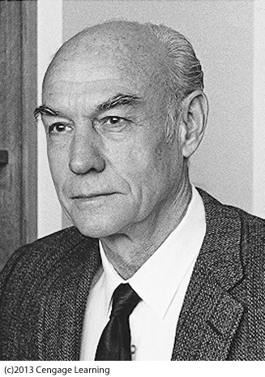
Pathfinding by Axons
Axons travel great distances
across brain to form correct connections
Sperry’s (1954) research with newts showed
→ axons follow chemical trail to reach target

Slide 67
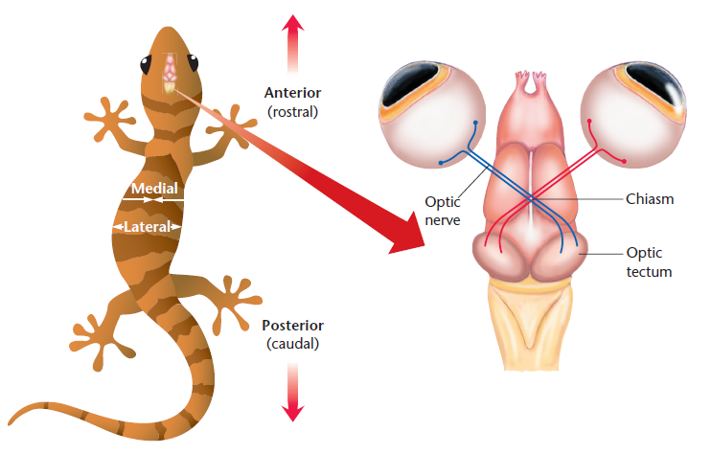
Specificity of Axon Connections-
First, Sperry showed that cutting the optic nerve led to growth of the nerve back to the correct location
(does NOT regrow in mammals!)
Figure 4.11- Connections from
eye to brain in a newt
Notes:
(Note: Figure 4.11 in the 12th edition is a frog)
Figure 4.11 Connections from eye to brain in a newt
The optic tectum is a large structure in fish, amphibians, reptiles, and birds. Note: Connections from eye to brain in a newt differ from those in a human, as described in the module on lateralization.

Slide 68
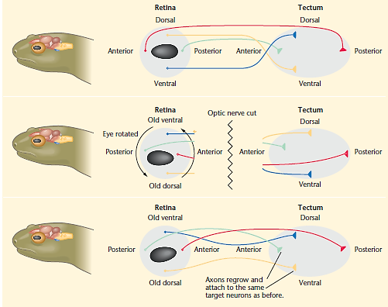
Nerve Connections in Newts-
Then, he showed that nerves grew back to original targets when eye was turned upside down
Notes:
Figure 4.12 Sperry’s experiment on nerve connections in newts
After he cut the optic nerve and inverted the eye, the axons grew back to their original targets, not to the targets corresponding to the eye’s current position. © Cengage Learning 2013

Slide 69
Pathfinding by Axons (cont’d.)
Growing axons reach target area by following gradient of chemicals
  attracted by some chemicals
  repelled by others

Slide 70
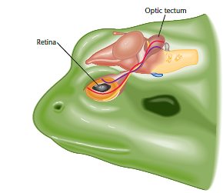
Chemical Gradients
Figure 4.13 Retinal axons find targets in the tectum by following chemical gradients
One protein is concentrated mostly in the dorsal retina and the ventral tectum. Axons rich in that protein attach to tectal neurons that are also rich in that chemical. A second protein directs axons from the posterior retina to the anterior portion of the tectum.
Notes:
Figure 4.13 Retinal axons find targets in the tectum by following chemical gradients
One protein is concentrated mostly in the dorsal retina and the ventral tectum. Axons rich in that protein attach to tectal neurons that are also rich in that chemical. A second protein directs axons from the posterior retina to the anterior portion of the tectum. © Cengage Learning 2013.

Slide 71
Cengage animation:
Specificity of axon connections

Slide 72
Competition among Axons as a General Principle
When axons initially reach targets
→ form synapses with several cells
Postsynaptic cells…
  strengthen connection with some cells
  eliminate connections with others
Formation/elimination of these connections depends upon input from incoming axons

Slide 73
Neural Darwinism
“Neural Darwinism”= term used by some theorists for selection process of neural connections
In competition amongst synaptic connections, initially more connections formed than needed
Most successful axon connections and combinations survive
→ others fail to sustain active synapses

Slide 74
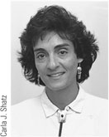
Carla Shatz (personal communication with textbook author)
Brain function depends on precision & patterns of its neural circuits
Sculpted from an early imprecise pattern
Connections verified by functioning of neurons themselves
Developing brain is not a miniature version of adult
Brain works to wire itself

Slide 75
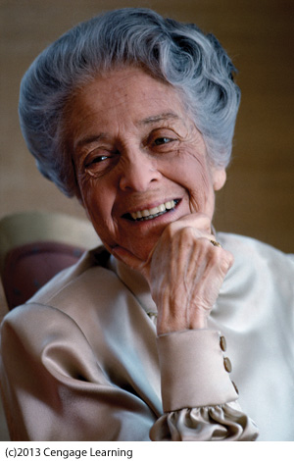
Determinants of Neuronal Survival
Nerve growth factor (NGF)= protein released by muscles- promotes survival
& growth of axons
Levi-Montalcini discovered:
muscles do not determine
how many axons form;
they determine how many
survive

Slide 76
Determinants of Neuronal Survival (cont’d.)
  Brain’s system…
    overproduce neurons
    then apply apoptosis
      (preprogrammed mechanism of cell death)
Enables exact matching…
# of incoming axons to # of receiving cells

Slide 77
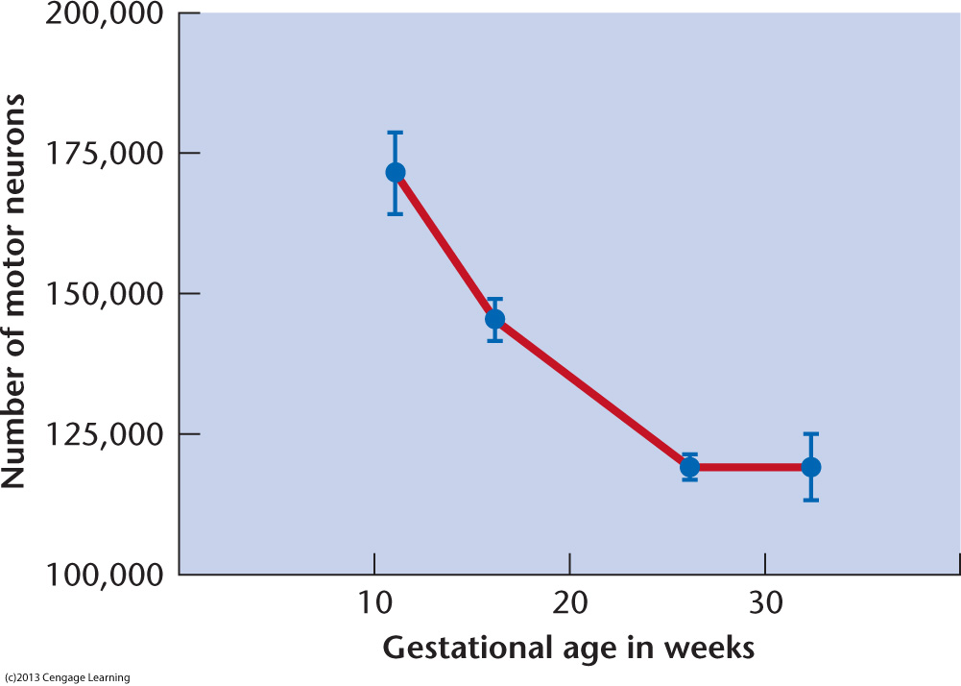
Figure 4.14- Cell loss during development of the
nervous system (motor neurons in spinal cord )

Slide 78
Neurotropins
Neurotropin= chemical that promotes survival & activity of neurons (i.e., NGF)
Axons not exposed to neurotropins after making connections undergo apoptosis
Therefore, healthy adult nervous system contains NO neurons that failed to make appropriate connections

Slide 79
Neuronal Death
Elimination & period of massive cell death→ part of normal development and maturation
After maturity, apoptotic mechanisms become dormant
Visual cortex is actually thicker in blind people due to lack of visual stimuli
  Ineffective neurons cannot be pruned out

Slide 80
Cengage CD video:
Brain development

Slide 81
The Vulnerable Developing Brain
Early stages of brain development
  critical for normal development later in life
One gene mutation…
  can lead to many defects
Chemical distortions during early development
  → can cause significant impairment and developmental problems

Slide 82
Fetal Alcohol Syndrome
Fetal alcohol syndrome=
condition children are born with if mother drinks heavily during pregnancy

Slide 83
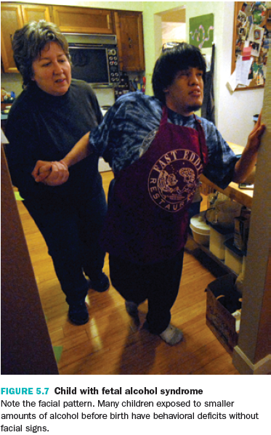
Fetal Alcohol Syndrome (cont’d.) (Figure not in 12th edition)
Characteristics:
  Hyperactivity and
  impulsiveness
  Difficulty maintaining
  attention
  Varying degrees of
  mental retardation
  Motor problems and
  heart defects
  Facial abnormalities

Slide 84
Fetal Alcohol Syndrome (cont’d.)
Dendrites of FAS children are short with few branches
Exposure to alcohol in fetal brain suppresses glutamate and enhances release of GABA
  →Many neurons consequently receive:
  less excitation
  less exposure to neurotropins than usual
    → undergo apoptosis

Slide 85

Cortical Thinning as a Result of Prenatal Alcohol Exposure
Figure 4.15 Cortical Thinning as a Result of Prenatal Alcohol Exposure
The cortical areas marked in red are thinner, on average, in adults whose mothers drank alcohol during pregnancy.
Notes:
Figure 4.15 Cortical Thinning as a Result of Prenatal Alcohol Exposure
The cortical areas marked in red are thinner, on average, in adults whose mothers drank alcohol during pregnancy.

Slide 86
Differentiation of the Cortex
Neurons in different parts of brain…
  → differ in shape & chemical components
Immature neurons transplanted early…
→ develop properties of new location
Neurons transplanted later…
→ develop some new properties
→ but retain some old properties
Example: ferret experiment

Slide 87
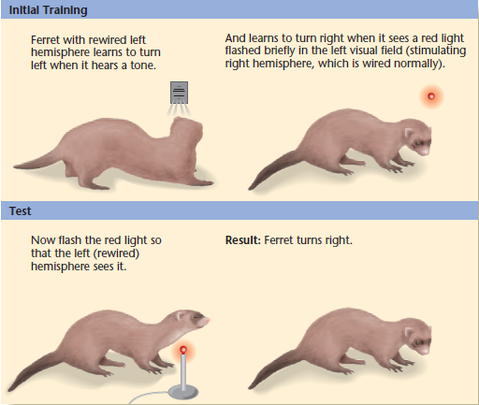
A Ferret with a Rewired Temporal Cortex (Figure 4.16)
First, the normal (right) hemisphere is trained to respond to a red light by turning to the right. Then, the rewired (left) hemisphere is tested with a red light. The fact that the ferret turns to the right indicates that it regards the stimulus as light, not sound.
Notes:
Figure 4.16 A ferret with rewired temporal cortex
First, the normal (right) hemisphere is trained to respond to a red light by turning to the right. Then, the rewired (left) hemisphere is tested with a red light. The fact that the ferret turns to the right indicates that it regards the stimulus as light, not sound. © Cengage Learning 2013.

Slide 88
PBS documentary (Secret Life of the Brain)- “The Baby’s Brain- Wider Than the Sky”
Excerpt from 25:03-29:08
This film is available on “Films on Demand” (listed in library databases)- you will need to use your Los Rios log in to access it

Slide 89
Fine-Tuning by Experience
Brain has some ability to reorganize in response to experience
  Axons & dendrites continue to modify structure & connections throughout lifetime
  Dendrites continually grow new spines
Gain & loss of spines indicates new connections, which relates to learning

Slide 90
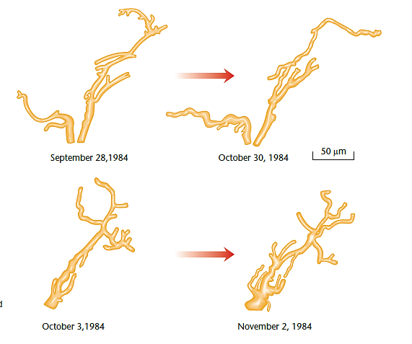
Changes in Dendritic Trees of Two Mouse Neurons (Figure 4.17)
During a month, some branches elongated and others retracted.
Notes:
Figure 4.17 Changes in dendritic trees of two mouse neurons
During a month, some branches elongated and others retracted. Source: Reprinted from “Changes in Dendritic Branching of Adult Mammalian Neurons Revealed by
Repeated Imaging in Situ,” by D. Purves and R. D. Hadley, Nature, 315, pp. 404–406. Reprinted by permission.

Slide 91
Experience and Dendritic Branching
Rats raised in enriched environment
→ thicker cortex
→ increased dendritic branching
Measurable expansion of neurons also shown in humans as a function of physical activity
(Hippocampus) Old neurons die by apoptosis & new ones form to take their place → improved learning and memory

Slide 92
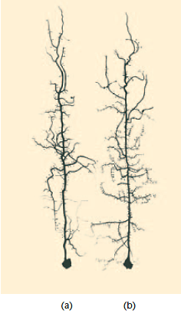
Effect of a Stimulating Environment
(Figure 4.18)
A jewelfish reared in isolation develops neurons with fewer branches.
(b) A fish reared with others has more dendritic branches.
Notes:
Figure 4.18 Effect of a stimulating environment
(a) A jewelfish reared in isolation develops neurons with fewer branches. (b) A fish reared with others has more dendritic branches. Source: Richard Coss.

Slide 93
Experience and Dendritic Branching (cont’d.)
Once believed that teaching a child difficult concepts (e.g., Greek, advanced math, etc.)→ enhance intelligence in other areas
  This concept is known as “far transfer”
Evidence shows: skills associated with the practiced task transfer, but not other skills
  The brain cannot be “exercised” like a muscle

Slide 94
Effects of Special Experiences
Blind people improve attention to touch and sound, based on practice
  Touch information activated occipital cortex area (ordinarily devoted to vision alone)
Occipital lobe adapts to also process tactile and verbal information

Slide 95
Brain Adaptations
People deaf from an early age become more responsive to touch and vision
→Auditory cortex adapts to process touch and vision

Slide 96
Music Training
MRI studies:
  Professional musicians- right temporal lobe is 30% larger than non-musicians
  Professional keyboard players- thicker gray matter in part of brain responsible for hand control and vision
  Results suggest practicing a skill reorganizes brain to maximize performance of that skill

Slide 97
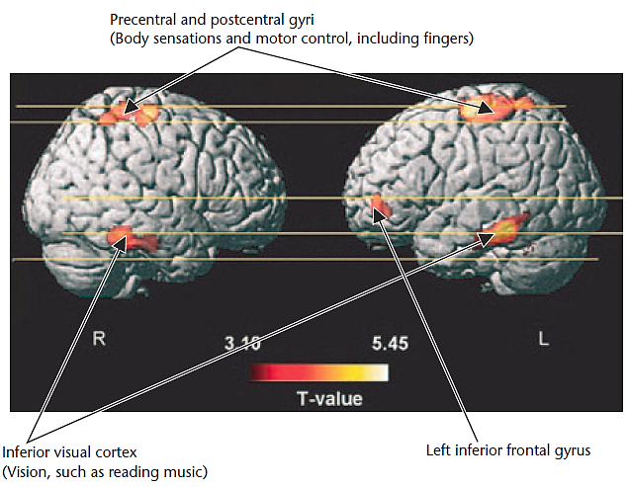
Brain Correlates of Music Practice (Figure 4.19)
Areas marked in red showed thicker gray matter among professional keyboard players than in amateurs and thicker among amateurs than in nonmusicians. Areas marked in yellow showed even stronger differences in that same direction.
Notes:
Figure 4.19 Brain correlates of music practice
Areas marked in red showed thicker gray matter among professional keyboard players than in amateurs and thicker among amateurs than in nonmusicians. Areas marked in yellow showed even stronger differences in that same direction. Source: Gaser & Schlaug, 2003 Special Training in Adulthood.

Slide 98
Special Training in Adulthood
Adult experiences can also modify brain anatomy
However, research is needed to determine whether the effects are strong enough to be observed with MRI or similar technology

Slide 99
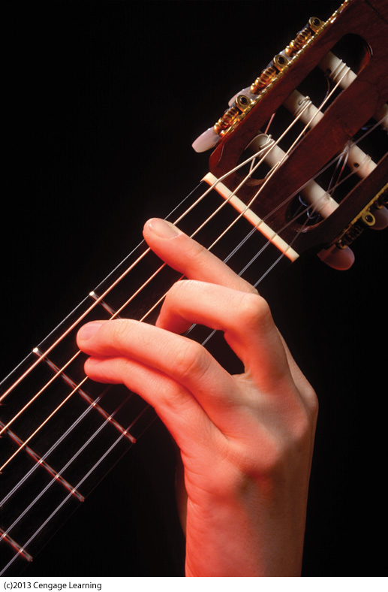
When Brain Reorganization Goes Too Far
Focal hand dystonia or “musicians cramp”-condition where brain
reorganization goes too far
  Fingers of those who practice
  extensively become clumsy,
  fatigue easily, and
  make involuntary movements
  Someone with musician’s cramp or writer’s cramp
  has difficulty moving one finger independently
  of others. One or more fingers may twitch or go
  into a constant contraction.

Slide 100
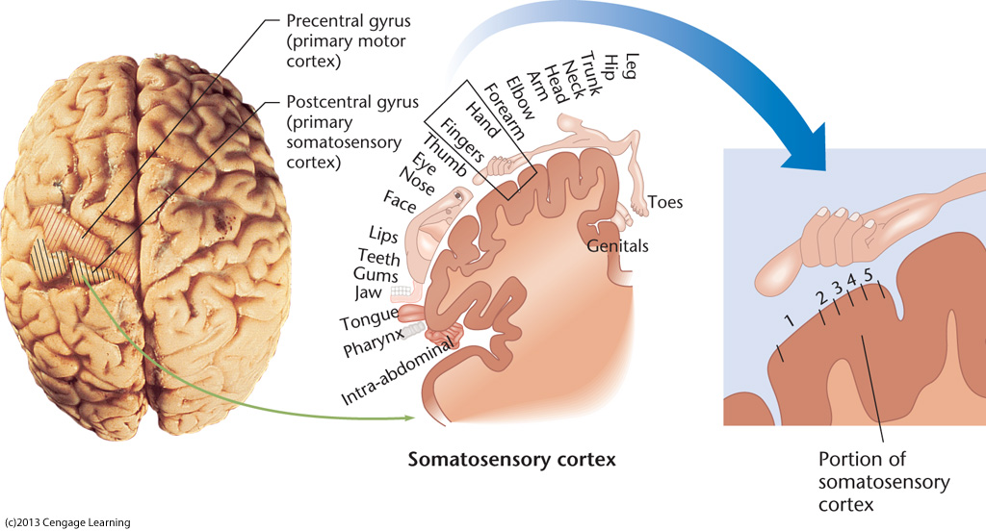
  Results from extensive reorganization of sensory thalamus and cortex…

Slide 101


  …so that touch responses to one finger overlap those of another

Slide 102
Brain Development and Behavioral Development (cont’d.)
Adolescents:
Tend to be more impulsive than adults
  problematic re: drinking, risky driving, sex, etc.
Tend to “discount the future”
Not equally impulsive in all situations
  Peers, amount of time given, etc., effect decisions
Prefrontal cortices relatively inactive in certain situations- may/may not be cause of impulsivity

Slide 103
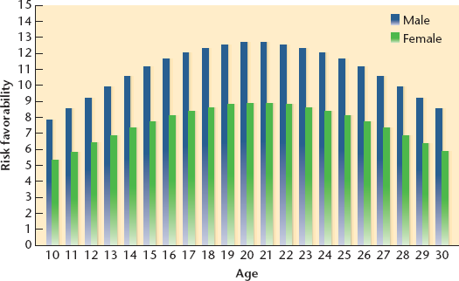
Changes in Attitudes toward Risky Behaviors
Figure 4.20 (new to 13th edition) Changes in Attitudes toward Risky Behaviors
People of various ages were asked how favorable they felt toward risky actions such as bicycling down a staircase or surfing in very high waves.
Notes:
Figure 4.20 (new to 13th edition) Changes in Attitudes toward Risky Behaviors
People of various ages were asked how favorable they felt toward risky actions such as bicycling down a staircase or surfing in very high waves.

Slide 104
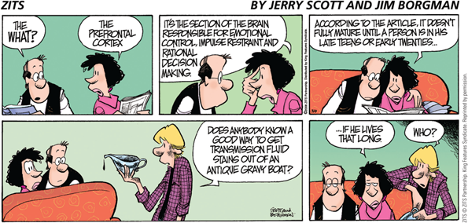
Adolescent (mis)judgment
(no longer in 13th edition)
Notes:
ZITS (no longer in 13th edition)
Comic from 3/9/08- by Jerry Scott & Jim Borgman

Slide 105
Brain Development and Old Age
Some neurons lose synapses, remaining synapses change more slowly than before in response to experiences
Brain structures begin to lose volume
Research underestimates older people:
  People vary re: intellectual decline
  Older people have greater knowledge base and experience- many find ways to compensate for losses

Slide 106
4.3 Plasticity after Brain Damage
Survivors of brain damage
→ subtle to significant behavioral recovery
Some recovery mechanisms are similar to brain development
→ new branching of axons & dendrites
Understanding recovery processes will give us new and improved therapies

Slide 107
Cengage video: Brain regrowth

Slide 108
Brain Damage and Short-Term Recovery
Possible causes of brain damage:
  Tumors
  Infections
  Exposure to toxic substances/radiation
  Degenerative diseases
  Closed head injuries

Slide 109
Brain Damage and Short-Term Recovery (cont’d.)
Closed head injury = sharp blow to head that does not puncture brain
  One of main causes of brain injury in young adults
  After severe injury, recovery can be slow and incomplete
Stroke or cerebrovascular accident = temporary loss of blood flow to brain
  Common cause of brain damage in elderly

Slide 110
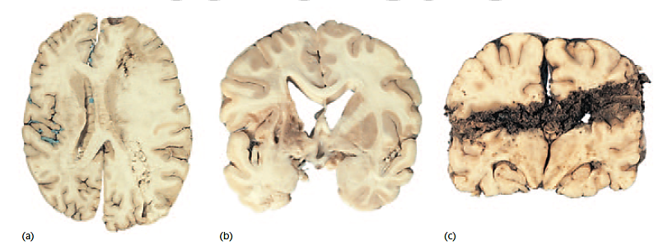
Three Examples of Damaged Human Brains (Figure 4.21)
(a) Brain of a person who died immediately after a stroke. Note the swelling on the right side. (b) Brain of someone who survived for a long time after a stroke. Note the cavities on the left side, where many cells were lost.
(c) Brain of a person who suffered a gunshot wound and died immediately.
Notes:
Figure 4.21 Three damaged human brains (4.20 in 12th edition)
(a) Brain of a person who died immediately after a stroke. Note the swelling on the right side. (b) Brain of someone who survived for a long time after a stroke. Note the cavities on the left side, where many cells were lost. (c) Brain of a person who suffered a gunshot wound and died immediately. Courtesy of Dana Copeland.

Slide 111
Types of Strokes
  Ischemia: most common type, resulting from blood clot or obstruction of an artery
    Neurons lose their oxygen and glucose supply
  Hemorrhage: less frequent type, resulting from a ruptured artery
    Neurons flooded with excess blood, calcium, oxygen, & other chemicals

Slide 112
Effects of Strokes
Ischemia & hemorrhage also cause:
  Edema: accumulation of fluid in brain
  → results in increased pressure on brain
  → increases probability of further strokes
  Disruption of sodium-potassium pump
    →leads to accumulation of potassium ions (K+) inside neurons

Slide 113
Effects of Strokes (cont’d.)
Edema & excess K+ triggers release of glutamate (excitatory neurotransmitter)
Overstimulation of neurons leads to excessive sodium & other ions entering neuron
Excess positive ions in neuron block metabolism in mitochondria → kills neuron

Slide 114
Immediate Treatments for Stroke
Tissue plasminogen activator (tPA)
  Drug that breaks up blood clots
  can reduce effects of ischemic strokes
Research attempting to stop neuron death by:
  Blocking glutamate synapses
  Blocking calcium entry

Slide 115
Immediate Treatments for Stroke (cont’d.)
Cooling the brain
  One of most effective laboratory methods used to minimize damage caused by strokes
  Protects the brain after ischemia by reducing:
    overstimulation,
    apoptosis, and
    inflammation

Slide 116
Immediate Treatments for Stroke (cont’d.)
Cannabanoids also potentially minimize cell loss after a stroke
Benefits most likely due to anti-inflammatory effects
  Most effective in laboratory animals when taken before the stroke
  Don’t try this at home… prolonged use of marijuana can cause a stroke!

Slide 117
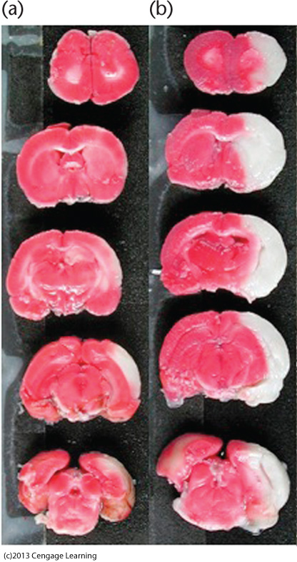
Figure 4.22- Effects of a
cannabinoid on stroke damage
Row (a) shows slices through
the brains of 5 rats treated with
a high dose of a cannabinoid
shortly after a stroke.
Row (b) shows slices for rats
not treated with cannabinoids.
The white areas on the right of
each brain show the extent of
the damage.
Notes:
(4.21 in 12th edition)

Slide 118
Later Mechanisms of Recovery from Brain Damage
Following brain damage
→ surviving brain areas increase or reorganize activity
Diaschisis: decreased activity of surviving neurons after damage to other neurons
  Since activity in one area stimulates other areas, damage to brain disrupts patterns of normal stimulation
  Stimulating activity in healthy brain regions (using drugs) may be a mechanism of later recovery

Slide 119
Later Mechanisms of Recovery (cont’d.)
Destroyed cell bodies cannot be replaced
Damaged axons do grow back under certain circumstances
  Crushed axon in peripheral nervous system follows its myelin sheath back to target and grows back toward periphery at a rate of ~1 mm/day
  If cut, myelin may not line up correctly
  → motor nerve may attach to wrong muscle

Slide 120
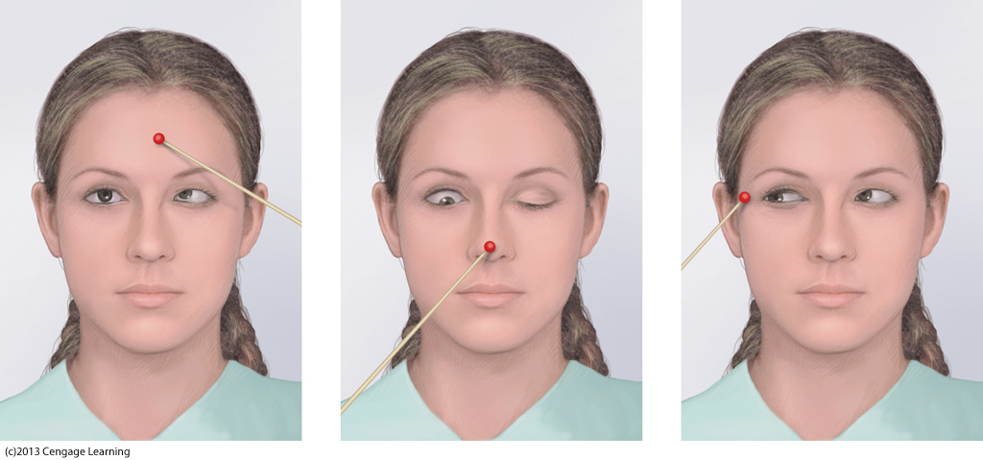
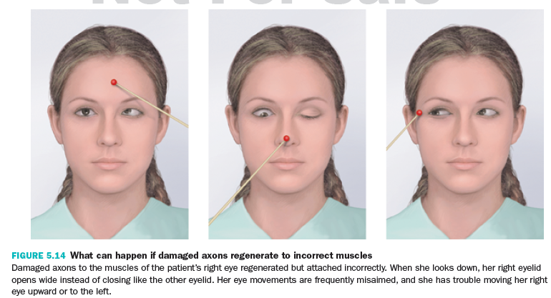
(Figure not in 12th/13th edition)

Slide 121
Regrowth of Axons
Damaged CNS (brain, spinal cord) axons do not readily regenerate in mature mammals
  Paralysis (spinal cord damage)- relatively permanent

Slide 122
Axon Sprouting
Cells that have lost source of innervation…
→ release neurotropins
→ induce axons to form collateral sprouts
Collateral sprouts = new branches formed by other non-damaged axons attaching to vacant receptors
Over several months, sprouts fill in most vacated synapses (can be useful, neutral, or harmful)

Slide 123
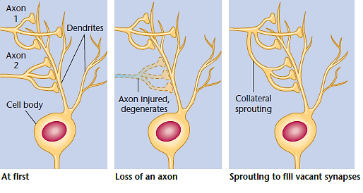
Collateral Sprouting (Figure 4.23)
A surviving axon grows a new branch to replace the synapses left vacant by a damaged axon.
Notes:
Figure 4.23 Collateral sprouting (4.22 in 12th edition)
A surviving axon grows a new branch to replace the synapses left vacant by a damaged axon. © Cengage Learning 2013.

Slide 124
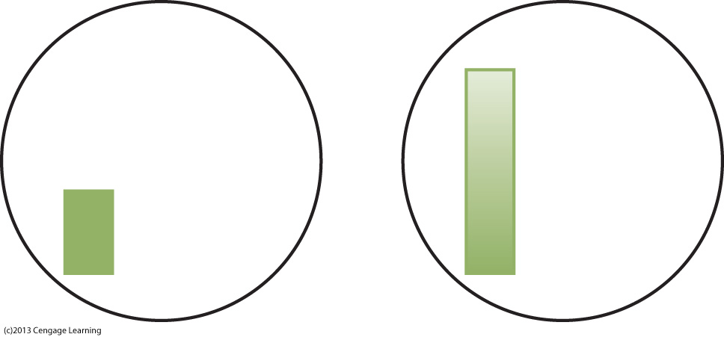
Example of useless/harmful sprouting- when stroke damages axons from upper-left visual field, axons from lower-left sprout into vacant spots. Stimulus that should appear as on left starts to appear as on right. (Figure not in 12th/13th edition.)

Slide 125
Denervation Supersensitivity
Postsynaptic cells deprived of synaptic inputs
  develop increased sensitivity to neurotransmitter
  to compensate for decreased input
Denervation supersensitivity: heightened sensitivity to a neurotransmitter after destruction of an incoming axon
  Can cause consequences such as chronic pain

Slide 126
Reorganized Sensory Representations and the Phantom Limb
Phantom limb = continued sensation from an amputated body part
  Cortex reorganizes itself after amputation by becoming responsive to other body parts
  Original axons degenerate leaving vacant synapses into which others axons sprout

Slide 127
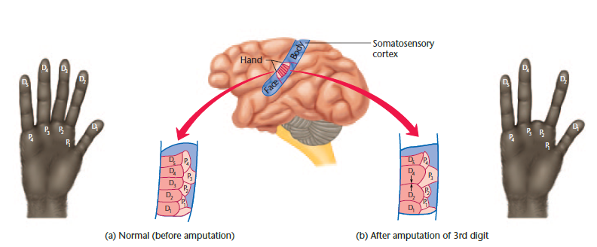
Somatosensory Cortex of a Monkey after a Finger Amputation (Figure 4.24)
Note that the cortical area previously responsive to the third finger (D3) becomes responsive to the second and fourth fingers (D2 and D4) and part of the palm (P3).
Notes:
Figure 4.24 Somatosensory cortex of a monkey after a finger amputation (4.23 in 12th edition)
Note that the cortical area previously responsive to the third finger (D3) becomes responsive to the second and fourth fingers (D2 and D4) and part of the palm (P3). Based on the Annual Review of Neuroscience, Vol. 6, 1983. © Cengage Learning 2013.

Slide 128
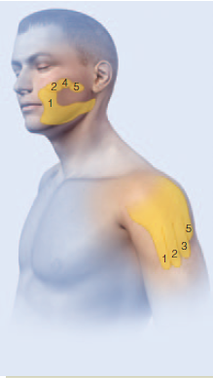
Sources of Phantom Sensation (Figure 4.24)
Phantom limb can lead to feeling sensations in amputated body part when other parts are stimulated
  e.g., a touch on the face can bring about the experience of a phantom arm
Stimulation in the areas marked on the cheek produced phantom sensations of digits 1 (thumb), 2, 4, and 5. Stimulation on the shoulder also evoked phantom sensations of digits 1, 2, 3, and 5.
Notes:
Figure 4.24 Sources of phantom sensation for one person (4.25 in 13th edition- silhouette also changed to white man)
Stimulation in the areas marked on the cheek produced phantom sensations of digits 1 (thumb), 2, 4, and 5. Stimulation on the shoulder also evoked phantom sensations of digits 1, 2, 3, and 5. Source: Based on Figure 5.29 from Phantoms in the Brain by V. S. Ramachandran, MD, PhD and Sandra Blakeslee/© Argosy Publishing Inc.

Slide 129
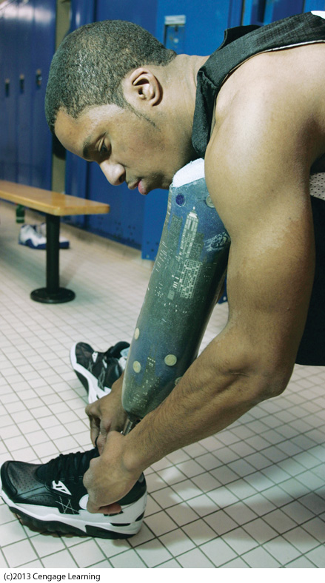
Cengage animation:
Phantom Limb
  Amputees who feel a phantom limb are likely to lose those phantom sensations if they learn to use an artificial arm or leg.

Slide 130
Learned Adjustments in Behavior
Deafferented limbs = limbs that have lost afferent sensory input
  Can still be used, but are often not- easier to use other ways to carry out the behavior
Study of ability to use deafferented limbs →development of therapy techniques to improve functioning of brain damaged people
  Focus on what they are capable of doing

Slide 131
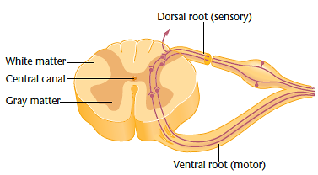
Cross-Section Through the Spinal Cord (Figure 4.26)
A cut through the dorsal root (as shown) deprives the animal of touch sensations from part of the body but leaves the motor nerves intact.
Notes:
Figure 4.26 Cross-section through the spinal cord (4.25 in 12th edition)
A cut through the dorsal root (as shown) deprives the animal of touch sensations from part of the body but leaves the motor nerves intact. © Cengage Learning 2013.

